Slide 1
G2M Insight For Cab Investment Firm
Tomisin A. Adeniyi
October, 2023.

Slide 2
Background – G2M (cab industry)
The Client
XYZ is a private firm in US. Due to remarkable growth in the Cab Industry in last few years and multiple key players in the market, it is planning for an investment in Cab industry and as per their Go-to-Market(G2M) strategy they want to understand the market before taking final decision.
The analysis has been divided into four parts:
Data Understanding
Finding the most profitable Cab company between Yellow Cab and Pink Cab
Forecasting profit for the 2019 Conclusion and Recommendations

Slide 3
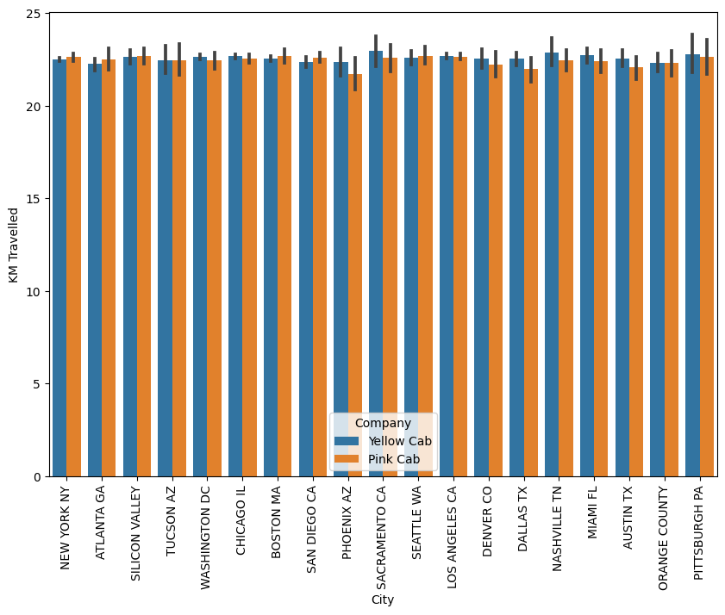
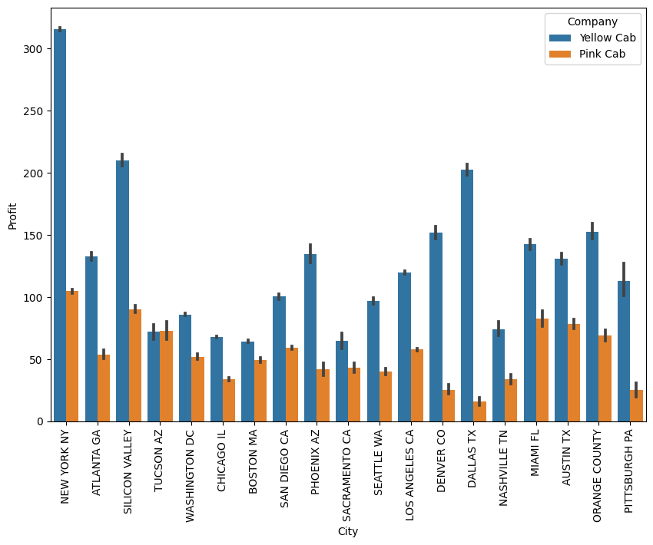
Profit by City
There is not much noticeable difference in the distance traveled by both the Pink Cab and the Yellow Cab in each city. Moreover, the profit between the two cab companies varies widely. Hence, the Yellow Cab company is more profitable across the cities.

Slide 4
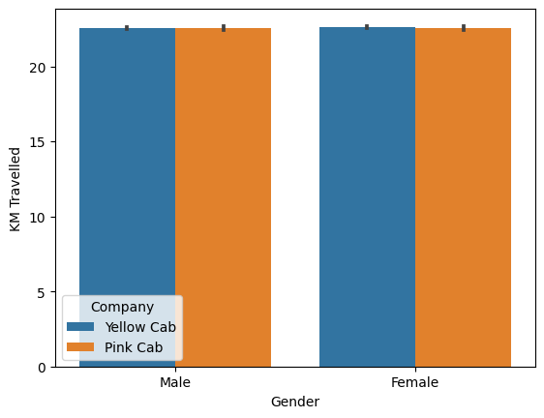
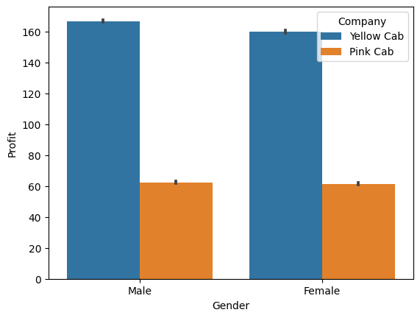
Profit by Gender
There is not much noticeable difference in the distance traveled by both Pink Cab and Yellow Cab, considering gender. Moreover, the profit margin between the two cab companies is very wide. Hence, the Yellow Cab company is more profitable across genders.

Slide 5
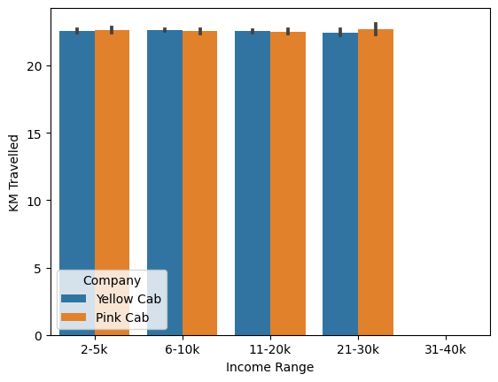
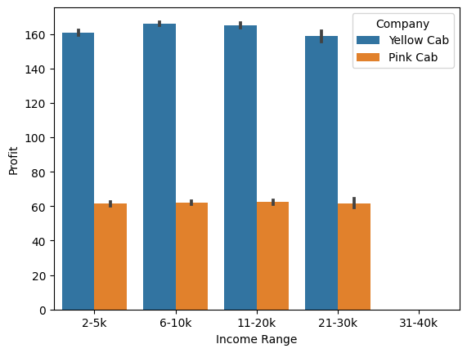
Profit by Income Range Analysis
There is not much noticeable difference in the distance traveled by both Pink Cab and Yellow Cab in each age range. Moreover, the profit margin between the two cab companies is very wide. Hence, the Yellow Cab company is more profitable across age ranges.

Slide 6
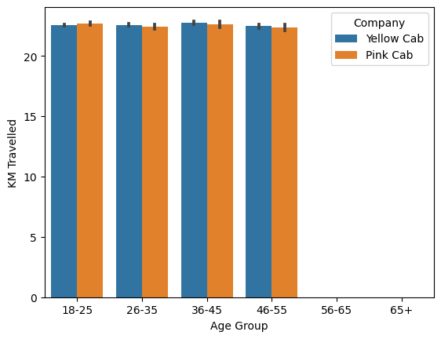
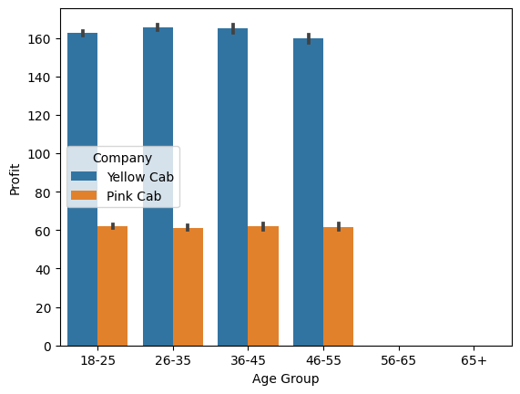
Profit by Age Group
There is not much noticeable difference in the distance traveled by both Pink Cab and Yellow Cab across different age groups. Moreover, the profit margin between the two cab companies is very wide. Hence, the Yellow Cab company is more profitable across the various age groups.

Slide 7
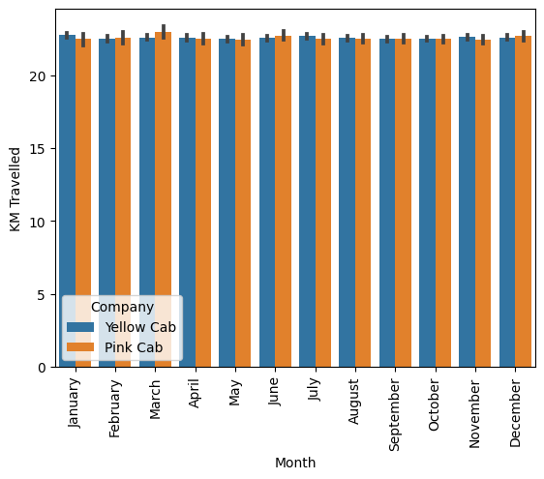
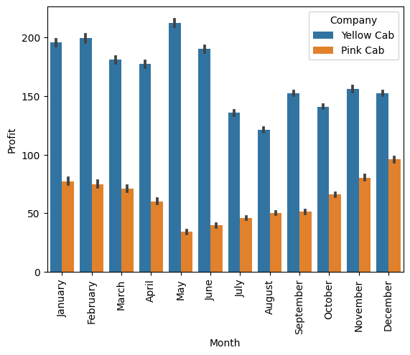
Profit by Month
There is not much noticeable difference in the distance traveled by both Pink Cab and Yellow Cab in each month. Moreover, the profit margin between the two cab companies is very wide. Hence, the Yellow Cab company is more profitable across the months.

Slide 8
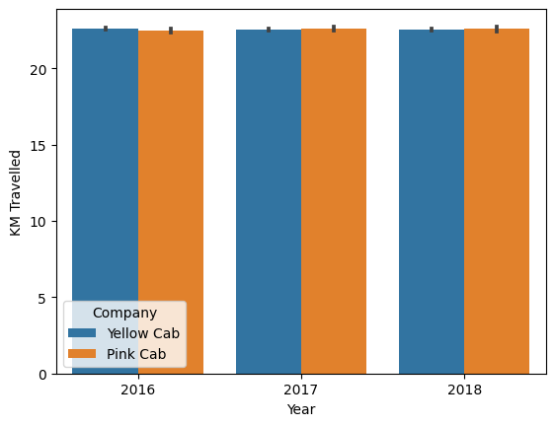
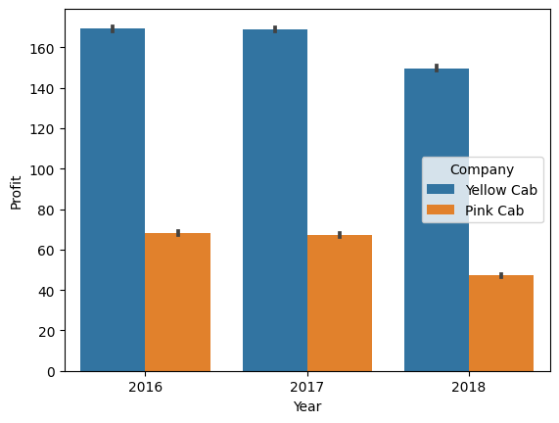
Profit by Year
There is not much noticeable difference in the distance traveled by both Pink Cab and Yellow Cab in each year. Moreover, the profit margin between the two cab companies is substantial. Hence, the Yellow Cab company is more profitable across the years.

Slide 9
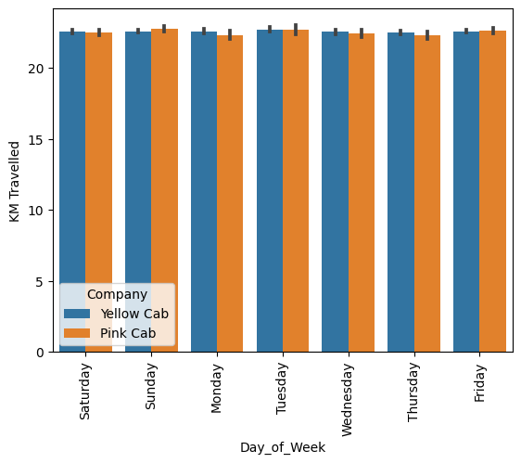
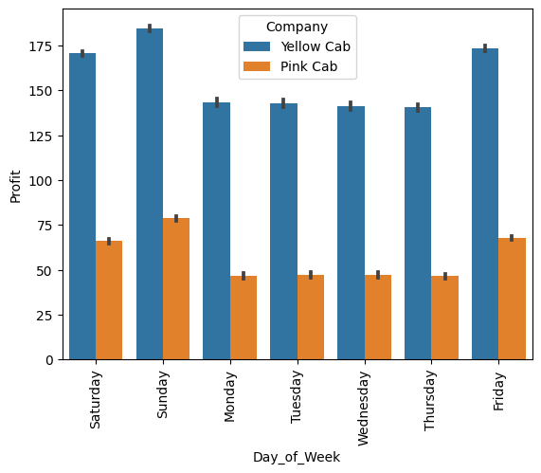
Profit by Day of the Week
There is no significant difference in the distance traveled by both the Pink Cab and the Yellow Cab on each day of the week. Moreover, the profit margin between the two cab companies is substantial. Hence, the Yellow Cab company is more profitable across the days of the week.

Slide 10
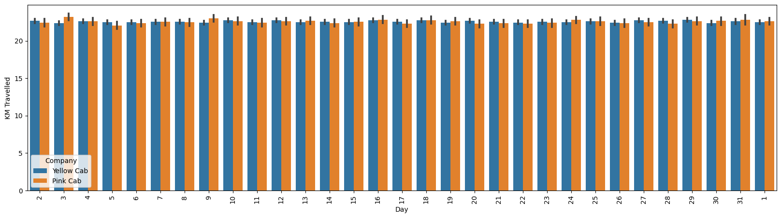
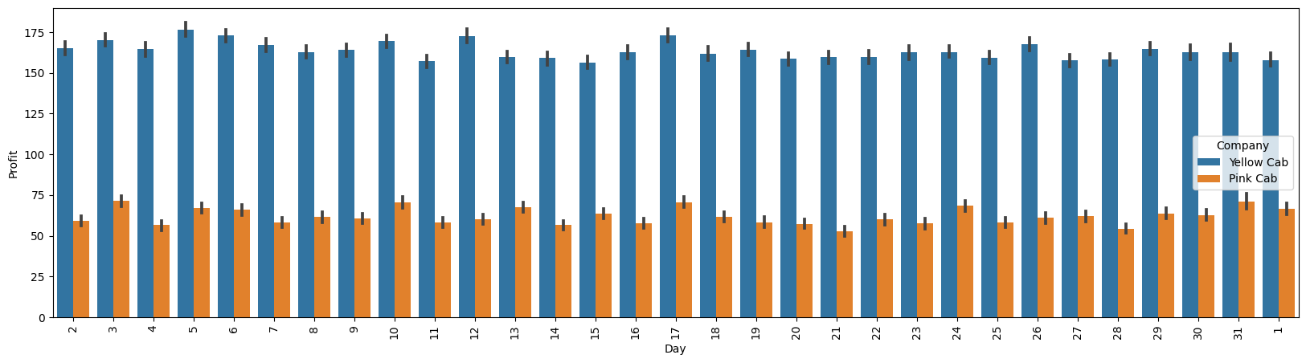
Profit by Day of the Month
There is not much noticeable difference in the distance traveled by both the Pink Cab and the Yellow Cab on each day of the month. Moreover, the profit margin between the two cab companies is very wide. Hence, the Yellow Cab company is more profitable across the days of the month.

Slide 11
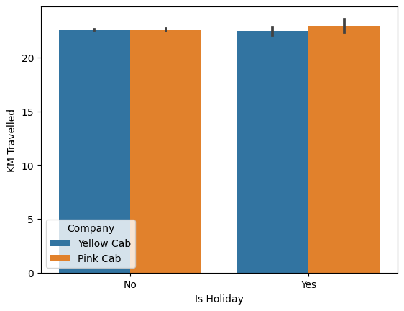
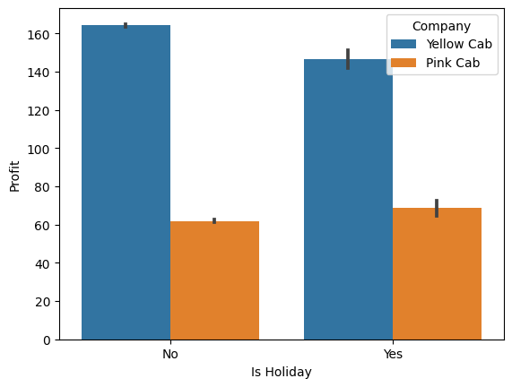
Profit by Holiday
There is not much noticeable difference in the distance traveled by both the Pink Cab and the Yellow Cab on holidays. Moreover, the profit margin between the two cab companies is substantial. Hence, the Yellow Cab company is more profitable, whether on holidays or not.

Slide 12

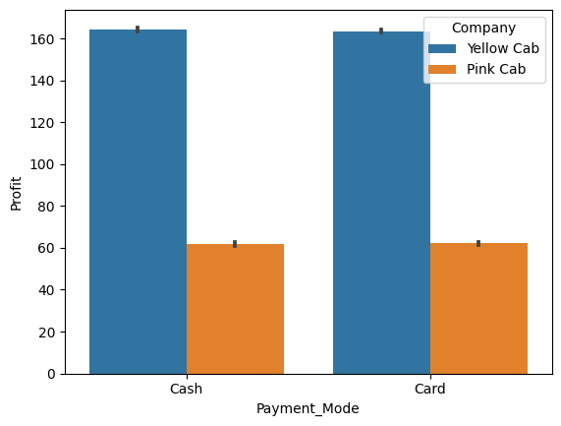
Profit by Payment Method
There is no significant difference in the distance traveled by both the Pink Cab and the Yellow Cab based on the payment mode. Moreover, the profit margin between the two cab companies is substantial. Hence, the Yellow Cab company is more profitable, whether customers pay by cash or card.

Slide 13
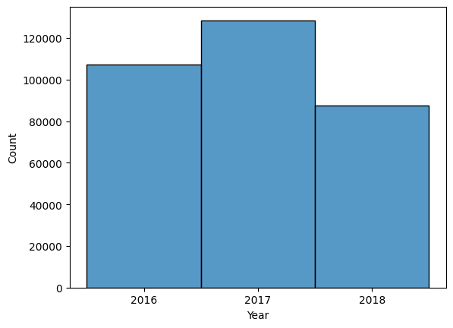
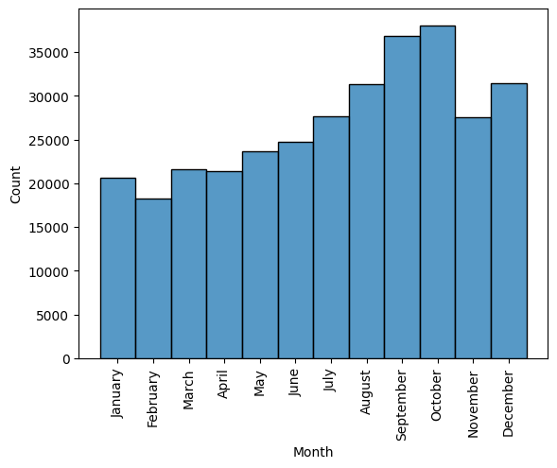
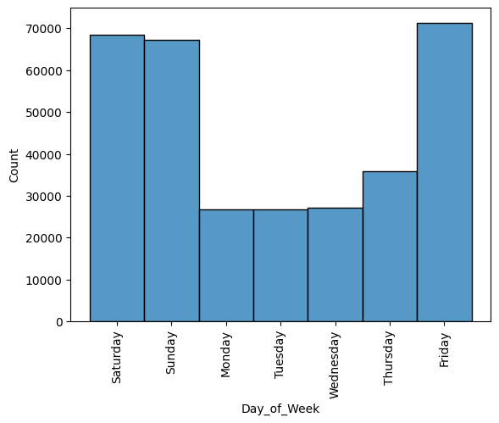
Distribution by Year, Month and Day of the Week

Slide 14
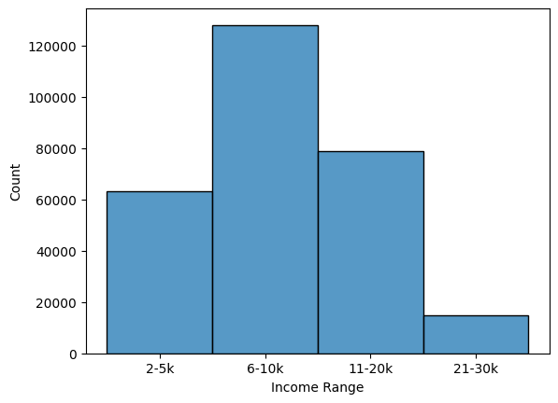
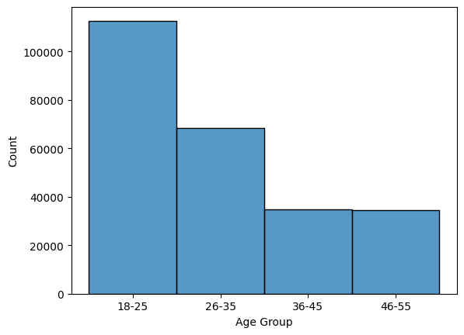
Distribution by Income Range and Age Group
People earning between $6,000 and $10,000 tend to patronize cab companies more, while those earning between $21,000 and $30,000 patronize them the least. The younger demographic, aged 18 to 25 years, shows a higher preference for cab services, followed by the age group of 26 to 35. Conversely, the older demographic tends to patronize cab companies less.

Slide 15
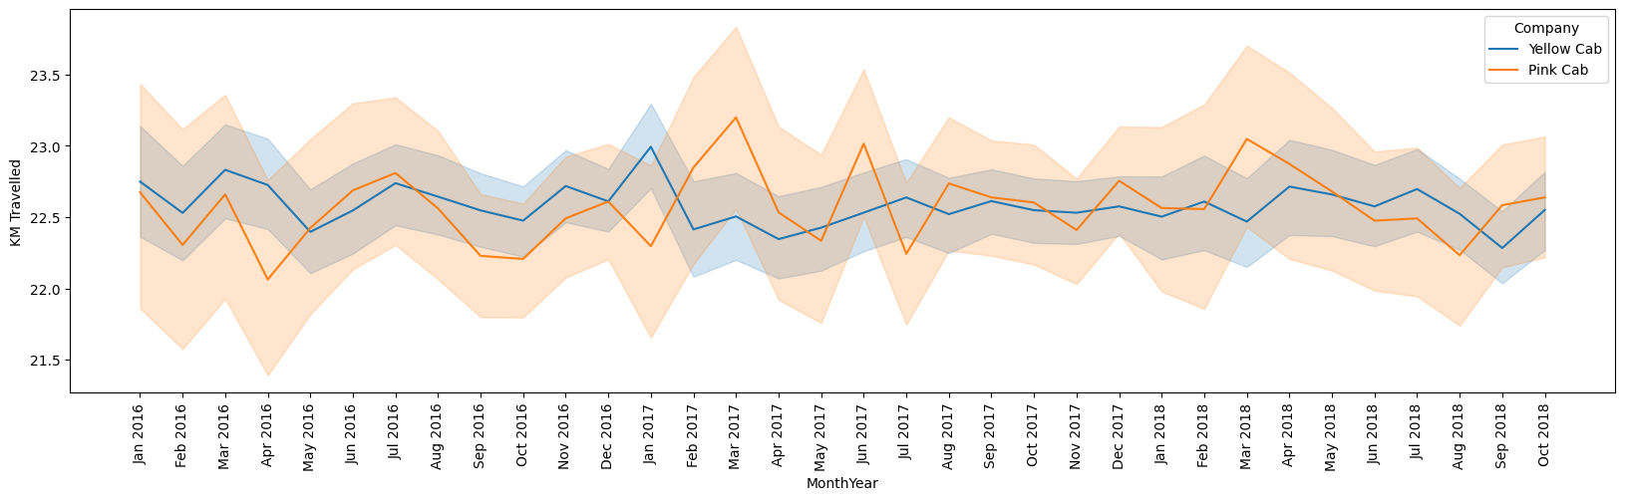
Trendline of Distance

Slide 16
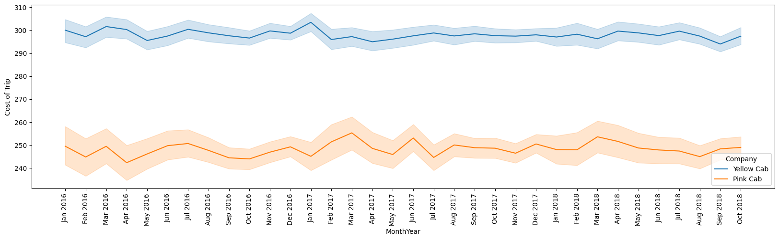
Trendline of Cost of Trip

Slide 17
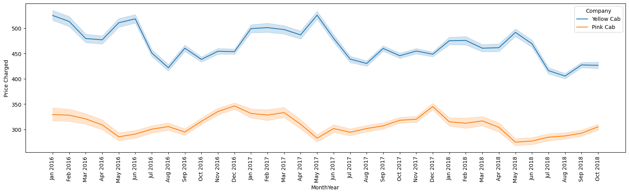
Trendline of Price Charged

Slide 18
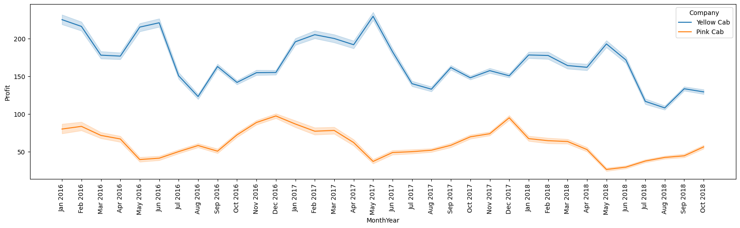
Trendline of Profit

Slide 19
Trendline of Distance, Cost of Trip, Price Charged and Profit
The distance covered on each trip was around 22-23 KM, and the cost of the trip has not changed significantly. Moreover, it can be observed that the price charged for each trip has been dropping, which has had a substantial impact on the profit margin. It is evident that profits have been declining since the year 2016 to 2018. Furthermore, the profit gap between Pink Cab and Yellow Cab companies is wide, with the Yellow Cab company making significantly higher profits than the Pink Cab company.

Slide 20
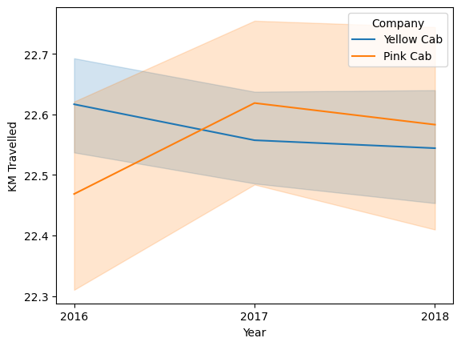
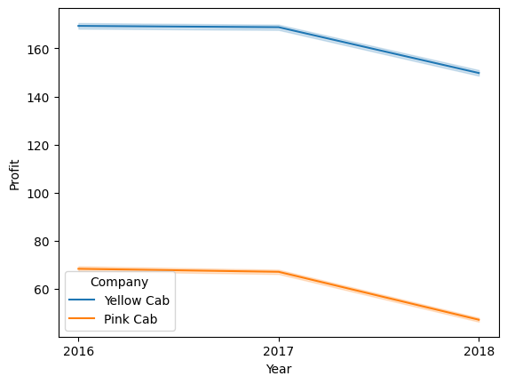
Trendline of Distance and Profit by Year
The average distance traveled increased from about 22.5 KM to about 22.6 KM for Pink Cab, while it slightly dropped from 22.6 KM for Yellow Cab. Moreover, Yellow Cab is making about $170 on each trip, while Pink Cab makes around $70, resulting in a difference of about $100. Hence, Yellow Cab has been more profitable.

Slide 21
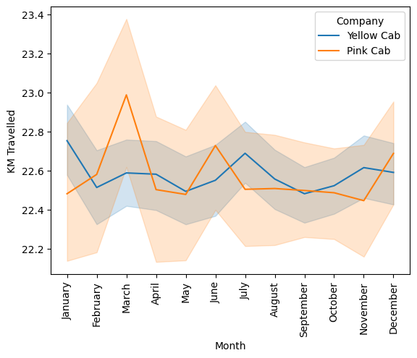
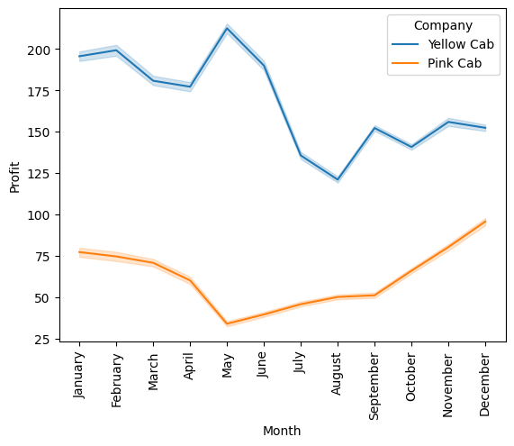
Trendline of Distance and Profit by Month
Yellow Cab company makes more profit in January and May every year and the least profit in August. On the other hand, Pink Cab company makes more money in December and January every year and the least profit in May. Moreover, Yellow Cab company makes a much higher profit.

Slide 22
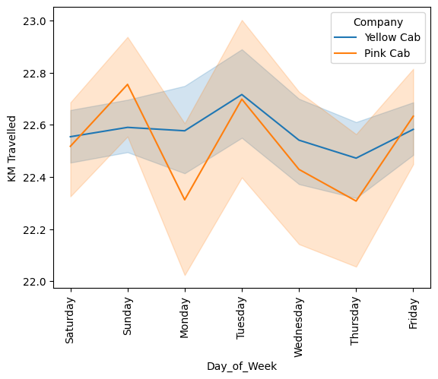
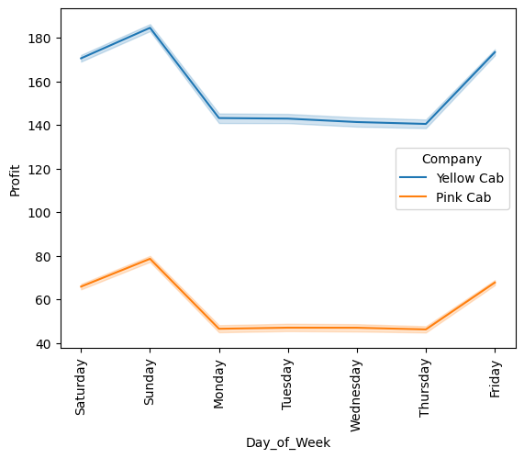
Trendline of Distance and Profit by Day of the Week
The two cab companies make more profit on Friday, Saturday, and Sunday, while they have relatively lower profits on weekdays. However, Yellow Cab company makes more profit.

Slide 23
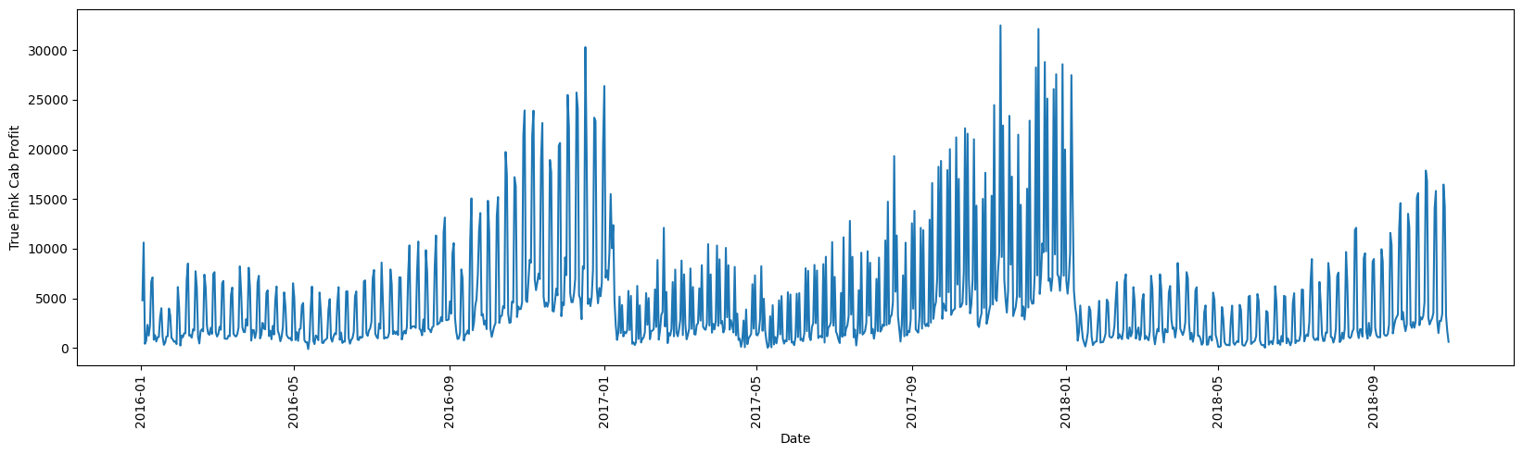
Pink Cab True Profit

Slide 24
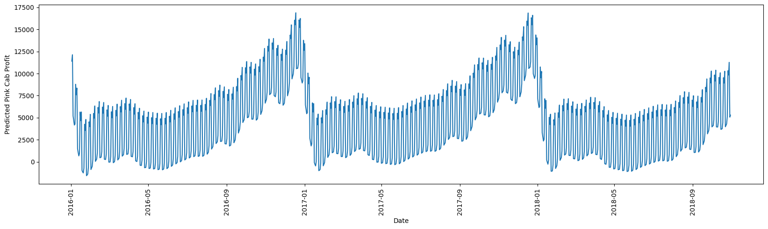
Pink Cab Predicted Profit
The model predicted the profit pattern, but the predicted profits do not match the true profits. This is because other factors (e.g., profits made in New York, NY, Silicon Valley, and Dallas, TX) contribute significantly to the overall profits. Further work will be done to predict more accurately.

Slide 25
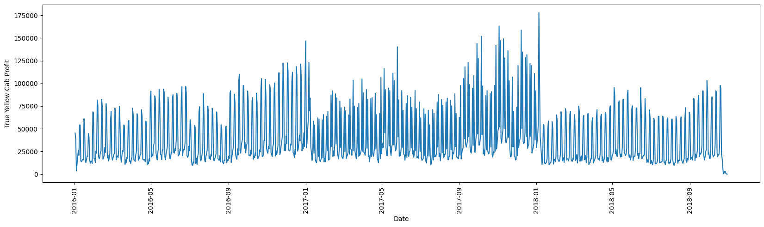
Yellow Cab True Profit

Slide 26
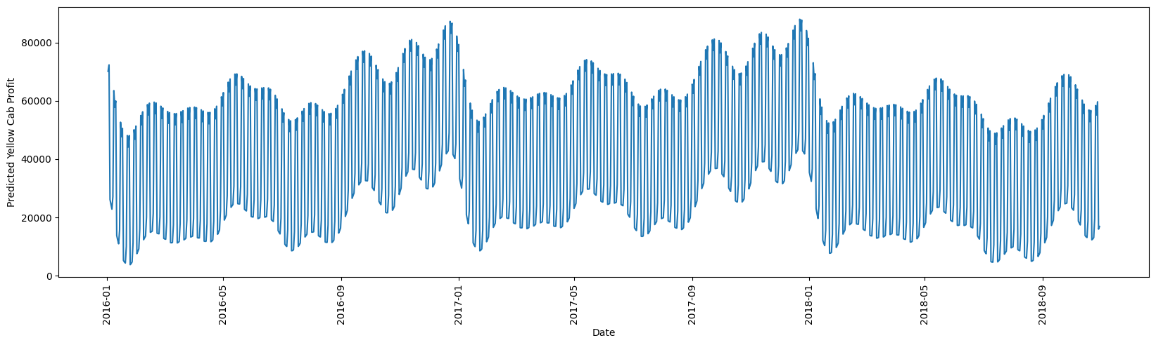
Yellow Cab Predicted Profit
"The model predicted the profit pattern, but the predicted profits do not match the true profits. This is because other factors (e.g., profits made in New York, NY, Silicon Valley, and Dallas, TX) contribute significantly to the overall profits. Further work will be done to predict more accurately.

Slide 27
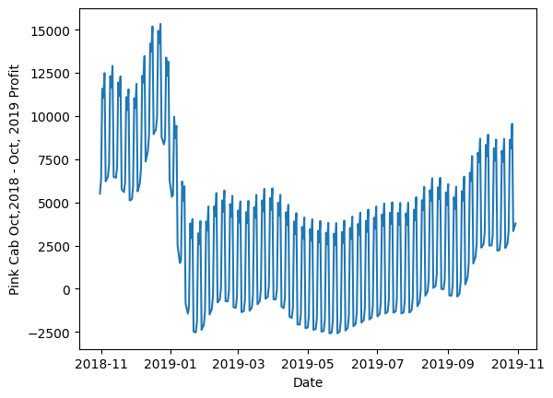
Pink Cab Profit Prediction for Year 2019
According to the model, Pink Cab company is expected to incur a loss of about $2,500 in January 2019 and then progressively increase its profit, reaching a peak of approximately $7,500 in October 2019.

Slide 28
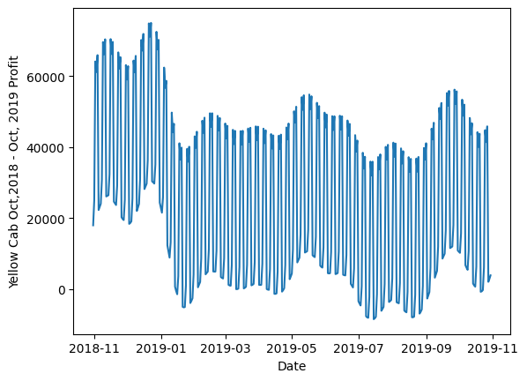
Yellow Cab Profit Prediction for Year 2019
According to the model, Yellow Cab company is expected to incur losses in January, July, and September 2019. However, the model also predicts that Yellow Cab will make substantial profits within the year.

Slide 29
Conclusion
Profitability Trends: The analysis reveals distinct patterns in the profitability of Pink Cab and Yellow Cab companies. However, Yellow Cab outperforms Pink Cab across all metrics. Both companies exhibit higher profits in December, January, February, March, and April, but while Yellow Cab peaks in May, Pink Cab has the least profit.
Geographical Variations: Profits seem to vary significantly based on location, with certain cities such as New York and Silicon Valley yielding higher profits than others. Moreover, while Yellow Cab had considerably high profits in Dallas, Pink Cab had little profit.
Day and Time Analysis: Both companies experience higher profits on weekends (Friday to Sunday) and lower profits on weekdays. This is likely because people go out for fun more on the weekend.
Age and Income Influence: Insights into customer behavior based on age and income reveal that younger people between 18 and 25 years patronize more, and patronage decreases as age increases. Also, the middle class, those earning between $6,000 and $10,000, patronize cabs more, while the high class, those earning between $21,000 and $30,000, patronizes cab services the least.

Slide 30
Recommendations
Investment Consideration: Based on the insights gained from the analysis, Yellow Cab outperformed Pink Cab across all metrics. Therefore, it is highly recommended to consider investing in Yellow Cab.
Profit Sustainability Investigation: While Yellow Cab has shown relatively higher profits, it's crucial to note that the price charged per trip has been dropping, resulting in reduced profits over the years. It is recommended to investigate the reasons behind the decreasing prices, especially considering that the cost of the trip is not reducing. This investigation will provide insights into sustaining and potentially increasing profits.

Slide 31
THE END

